Slide 1



Slide 2


mathXplorer

Slide 3




Adib Sakhawat
210042106
Tahsin Islam
210042137
Takia Farhin
210042117
mathXplorer
3

Slide 4
PROBLEM STATEMENT
The need for an interactive and competitive platform that enhances
mathematical understanding through guided problem-solving,
dynamic feedback, and community engagement.
mathXplorer
4
Notes:
In traditional math learning environments, students often struggle to achieve a deep, conceptual understanding of mathematical concepts. Many online platforms provide problem-solving opportunities, but they lack interactive elements that foster guided learning and intellectual dialogue. Moreover, there is limited scope for dynamic feedback, adaptive challenges, and competitive engagement, which can further discourage students from exploring advanced math topics.
This lack of engagement and interaction leaves a gap for learners who would benefit from personalized guidance, community-driven problem-solving, and a competitive platform to track progress and skills development.
MathXplorer aims to fill this gap by offering an interactive web-based platform that combines math problem-solving with competitive challenges, an adaptive rating system, and a unique Socratic dialogue-based chatbot. This platform will provide learners with personalized guidance, help them think critically, and foster a community that encourages collaborative and competitive learning.

Slide 5
Project Overview
MathXplorer is an interactive web platform designed to elevate math
learning through problem-solving and competition. It features a
Socratic dialogue-based chatbot that guides users with thought-provoking
questions, a flexible answer submission system, and a rating mechanism
inspired by the Codeforces Elo system. With features like personalized
challenges, community-driven engagement, and real-time progress tracking,
MathXplorer aims to foster a vibrant, collaborative environment for math
enthusiasts of all levels.
mathXplorer
5
Notes:
In traditional math learning environments, students often struggle to achieve a deep, conceptual understanding of mathematical concepts. Many online platforms provide problem-solving opportunities, but they lack interactive elements that foster guided learning and intellectual dialogue. Moreover, there is limited scope for dynamic feedback, adaptive challenges, and competitive engagement, which can further discourage students from exploring advanced math topics.
This lack of engagement and interaction leaves a gap for learners who would benefit from personalized guidance, community-driven problem-solving, and a competitive platform to track progress and skills development.
MathXplorer aims to fill this gap by offering an interactive web-based platform that combines math problem-solving with competitive challenges, an adaptive rating system, and a unique Socratic dialogue-based chatbot. This platform will provide learners with personalized guidance, help them think critically, and foster a community that encourages collaborative and competitive learning.

Slide 6
Features
Authorized user can
Authenticate them
Solve questions
Attend contests
Throw challenge
Write blogs
Do community interactions
Gain rating
Chat with the Socratic Bot
mathXplorer
6
Notes:
In traditional math learning environments, students often struggle to achieve a deep, conceptual understanding of mathematical concepts. Many online platforms provide problem-solving opportunities, but they lack interactive elements that foster guided learning and intellectual dialogue. Moreover, there is limited scope for dynamic feedback, adaptive challenges, and competitive engagement, which can further discourage students from exploring advanced math topics.
This lack of engagement and interaction leaves a gap for learners who would benefit from personalized guidance, community-driven problem-solving, and a competitive platform to track progress and skills development.
MathXplorer aims to fill this gap by offering an interactive web-based platform that combines math problem-solving with competitive challenges, an adaptive rating system, and a unique Socratic dialogue-based chatbot. This platform will provide learners with personalized guidance, help them think critically, and foster a community that encourages collaborative and competitive learning.

Slide 7
Features
Admin Can
Create new problems
Approve user submitted problems
Host contests
Ban users
Handle report on community
Moderate blogs and comments
Manage the usage of bot
mathXplorer
7
Notes:
In traditional math learning environments, students often struggle to achieve a deep, conceptual understanding of mathematical concepts. Many online platforms provide problem-solving opportunities, but they lack interactive elements that foster guided learning and intellectual dialogue. Moreover, there is limited scope for dynamic feedback, adaptive challenges, and competitive engagement, which can further discourage students from exploring advanced math topics.
This lack of engagement and interaction leaves a gap for learners who would benefit from personalized guidance, community-driven problem-solving, and a competitive platform to track progress and skills development.
MathXplorer aims to fill this gap by offering an interactive web-based platform that combines math problem-solving with competitive challenges, an adaptive rating system, and a unique Socratic dialogue-based chatbot. This platform will provide learners with personalized guidance, help them think critically, and foster a community that encourages collaborative and competitive learning.

Slide 8
Use Cases
Users register, log in, and track personal progress through visual analytics.
They participate in contests with a dynamic rating system
The Socratic chatbot guides users through problem-solving with engaging, question-based support.
mathXplorer
8
Notes:
In traditional math learning environments, students often struggle to achieve a deep, conceptual understanding of mathematical concepts. Many online platforms provide problem-solving opportunities, but they lack interactive elements that foster guided learning and intellectual dialogue. Moreover, there is limited scope for dynamic feedback, adaptive challenges, and competitive engagement, which can further discourage students from exploring advanced math topics.
This lack of engagement and interaction leaves a gap for learners who would benefit from personalized guidance, community-driven problem-solving, and a competitive platform to track progress and skills development.
MathXplorer aims to fill this gap by offering an interactive web-based platform that combines math problem-solving with competitive challenges, an adaptive rating system, and a unique Socratic dialogue-based chatbot. This platform will provide learners with personalized guidance, help them think critically, and foster a community that encourages collaborative and competitive learning.

Slide 9
Use Cases
Users create and share custom challenges, interacting with the community through blogs and comments.
Admins manage contests, approve questions, and ensure a safe, engaging platform experience.
mathXplorer
9
Notes:
In traditional math learning environments, students often struggle to achieve a deep, conceptual understanding of mathematical concepts. Many online platforms provide problem-solving opportunities, but they lack interactive elements that foster guided learning and intellectual dialogue. Moreover, there is limited scope for dynamic feedback, adaptive challenges, and competitive engagement, which can further discourage students from exploring advanced math topics.
This lack of engagement and interaction leaves a gap for learners who would benefit from personalized guidance, community-driven problem-solving, and a competitive platform to track progress and skills development.
MathXplorer aims to fill this gap by offering an interactive web-based platform that combines math problem-solving with competitive challenges, an adaptive rating system, and a unique Socratic dialogue-based chatbot. This platform will provide learners with personalized guidance, help them think critically, and foster a community that encourages collaborative and competitive learning.

Slide 10









Tools and Technology
mathXplorer
10
Notes:
In traditional math learning environments, students often struggle to achieve a deep, conceptual understanding of mathematical concepts. Many online platforms provide problem-solving opportunities, but they lack interactive elements that foster guided learning and intellectual dialogue. Moreover, there is limited scope for dynamic feedback, adaptive challenges, and competitive engagement, which can further discourage students from exploring advanced math topics.
This lack of engagement and interaction leaves a gap for learners who would benefit from personalized guidance, community-driven problem-solving, and a competitive platform to track progress and skills development.
MathXplorer aims to fill this gap by offering an interactive web-based platform that combines math problem-solving with competitive challenges, an adaptive rating system, and a unique Socratic dialogue-based chatbot. This platform will provide learners with personalized guidance, help them think critically, and foster a community that encourages collaborative and competitive learning.

Slide 11
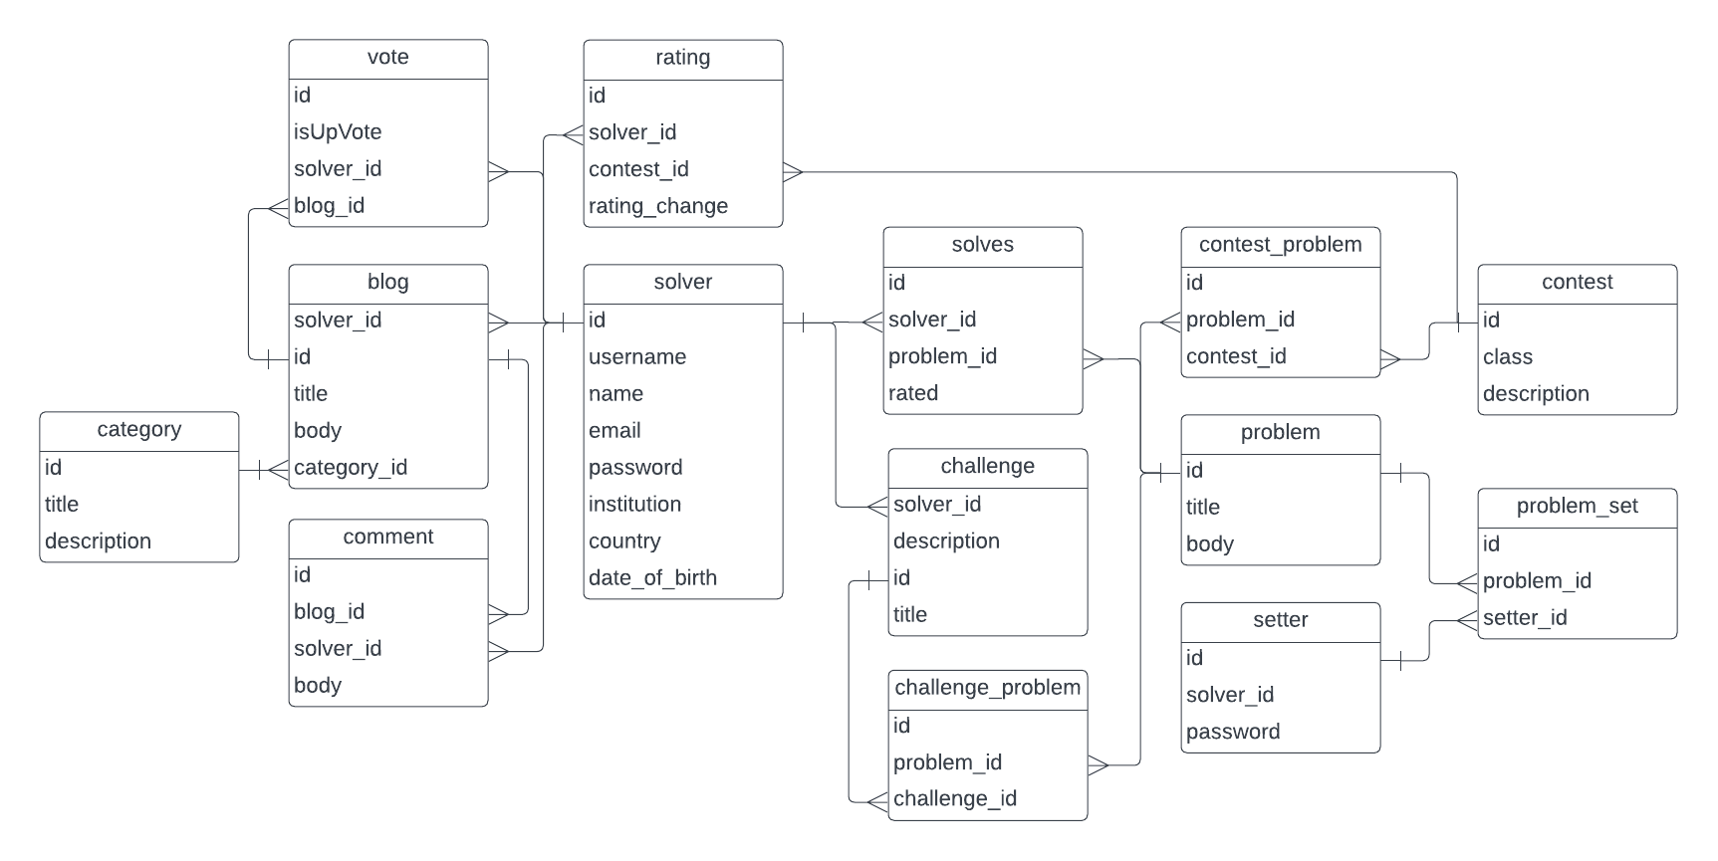
Database
mathXplorer
11
Notes:
In traditional math learning environments, students often struggle to achieve a deep, conceptual understanding of mathematical concepts. Many online platforms provide problem-solving opportunities, but they lack interactive elements that foster guided learning and intellectual dialogue. Moreover, there is limited scope for dynamic feedback, adaptive challenges, and competitive engagement, which can further discourage students from exploring advanced math topics.
This lack of engagement and interaction leaves a gap for learners who would benefit from personalized guidance, community-driven problem-solving, and a competitive platform to track progress and skills development.
MathXplorer aims to fill this gap by offering an interactive web-based platform that combines math problem-solving with competitive challenges, an adaptive rating system, and a unique Socratic dialogue-based chatbot. This platform will provide learners with personalized guidance, help them think critically, and foster a community that encourages collaborative and competitive learning.

Slide 12
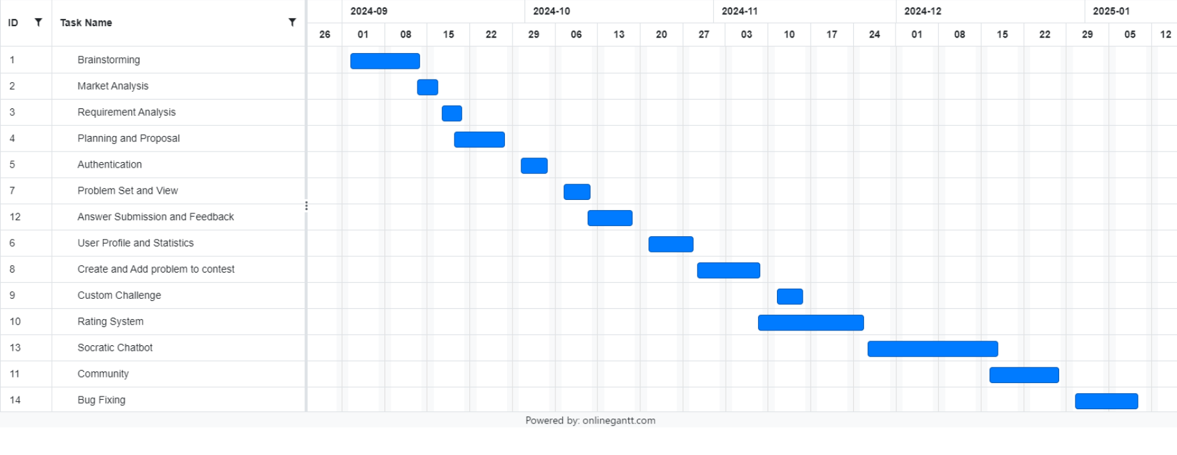
TimeLine
Progress
presentation
mathXplorer
12
Notes:
In traditional math learning environments, students often struggle to achieve a deep, conceptual understanding of mathematical concepts. Many online platforms provide problem-solving opportunities, but they lack interactive elements that foster guided learning and intellectual dialogue. Moreover, there is limited scope for dynamic feedback, adaptive challenges, and competitive engagement, which can further discourage students from exploring advanced math topics.
This lack of engagement and interaction leaves a gap for learners who would benefit from personalized guidance, community-driven problem-solving, and a competitive platform to track progress and skills development.
MathXplorer aims to fill this gap by offering an interactive web-based platform that combines math problem-solving with competitive challenges, an adaptive rating system, and a unique Socratic dialogue-based chatbot. This platform will provide learners with personalized guidance, help them think critically, and foster a community that encourages collaborative and competitive learning.

Slide 13
DEMONSTRATION
mathXplorer
13
Notes:
In traditional math learning environments, students often struggle to achieve a deep, conceptual understanding of mathematical concepts. Many online platforms provide problem-solving opportunities, but they lack interactive elements that foster guided learning and intellectual dialogue. Moreover, there is limited scope for dynamic feedback, adaptive challenges, and competitive engagement, which can further discourage students from exploring advanced math topics.
This lack of engagement and interaction leaves a gap for learners who would benefit from personalized guidance, community-driven problem-solving, and a competitive platform to track progress and skills development.
MathXplorer aims to fill this gap by offering an interactive web-based platform that combines math problem-solving with competitive challenges, an adaptive rating system, and a unique Socratic dialogue-based chatbot. This platform will provide learners with personalized guidance, help them think critically, and foster a community that encourages collaborative and competitive learning.

